Slide 1

iNovum Survey Results
& Using
Addressable Minds
Segment Messaging to Increase Revenue

Slide 2

Agenda
Survey Objective
Survey Methodology
Executive Summary
Review of Study Results & Typing Tool
  Segmentation
  Messaging
  Typing Tool Creation
Demographic Characteristics
Next Steps

Slide 3
Bringing Actionable Science to College & University
Admission & Marketing Plans
Survey Methodology
Reading the Mind of the Student:
Notes:
3

Slide 4

Identifying the particular mind-set to which a student belongs: in 5 to 10 seconds by asking a few simple questions
Survey Methodology

Slide 5

That everyone in your school knows exactly what to say at every student contact point…
Survey Methodology

Slide 6

Increasing enrollments, retention and student satisfaction with an easy to use tool that is more cost effective than other marketing methods
Survey Methodology
IT’S A “NO BRAINER!”

Slide 7
Who’s Using It?

Slide 8
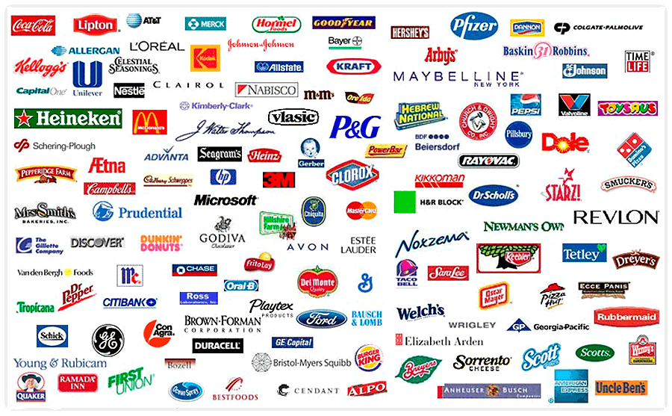

Slide 9
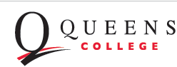
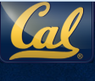
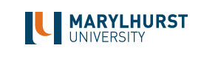

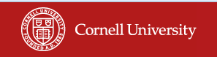
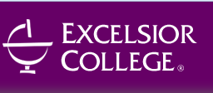

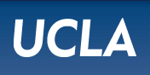

Academic Portfolio
Beginning To Grow

Slide 10

The Inventor: Dr. Howard Moskowitz
  Is the President of Moskowitz Jacobs Inc. and holds a
  Ph.D. in Experimental Psychology from Harvard
  University. Chairman, iNovum
  Won two of the most prestigious awards in his field
  2010 Walston Chubb Award for Innovation across all
  sciences, Sigma Xi, The Scientific Research Society, international Awarded for Mind Genomics: The science underlying the technology discussed in this presentation.
  2005 Charles Coolidge Parlin Marketing Research
  Award
  The “Nobel Prize” of Market Research, received only by
  the pioneers of market research.
  Recipients include Arthur Nielsen, George Gallup,
  Michael Porter, Peter Drucker, David Ogilvy and Philip Kotler.

Slide 11

Dr. Howard Moskowitz
…a renowned author and speaker on innovation,…
Selling Blue Elephants: “How to make great products that people want before
they even know they want them.“
26 books and 400 + scientific publications on the mind of the consumer.
Lectures on innovation at Wharton, Harvard, Yale, Columbia and numerous business schools.
Malcolm Gladwell TED talk
http://www.ted.com/talks/malcolm_gladwell_on_spaghetti_sauce.html

Slide 12
How Does it Work?

Slide 13



Slide 14
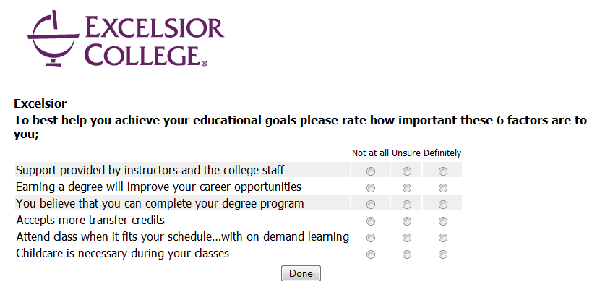

The Typing Tool:
Just A Few Simple Questions

Slide 15
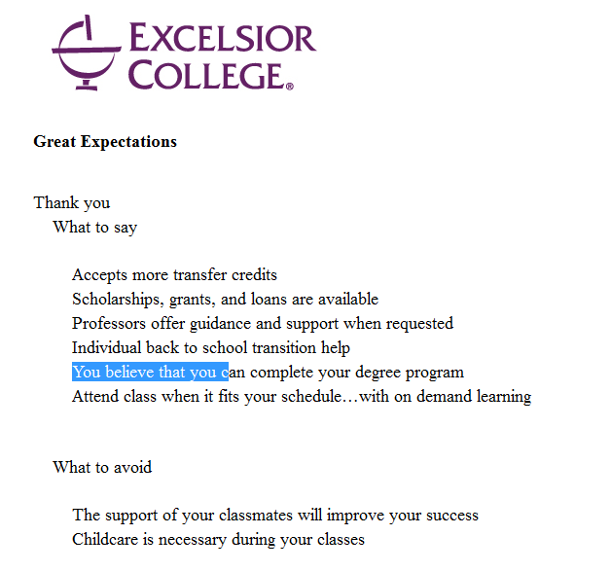

On The Spot: Know What To Say
And What NOT To Say with segment specific messages

Slide 16
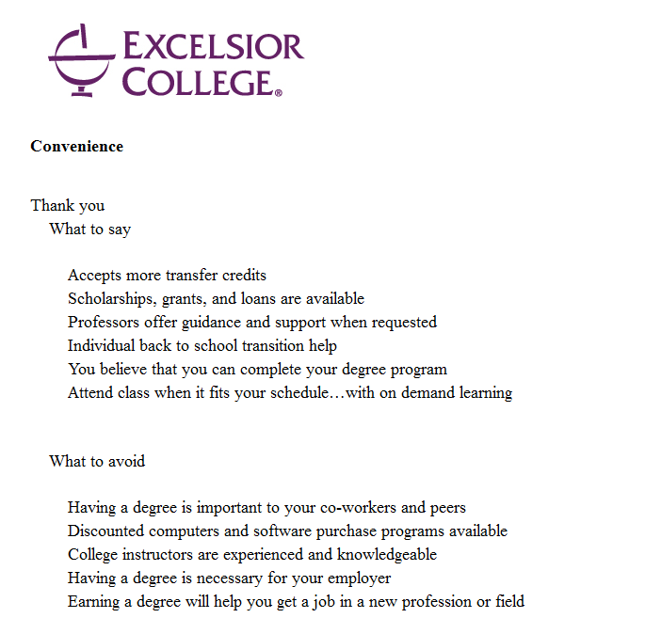

On The Spot: Know What To Say
And What NOT To Say with segment specific messages

Slide 17
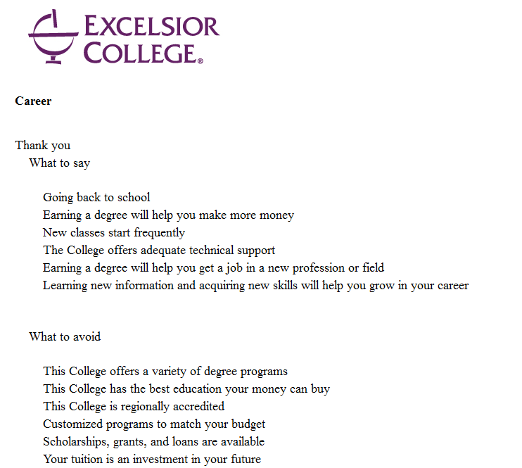

On The Spot: Know What To Say
And What NOT To Say with segment specific messages

Slide 18
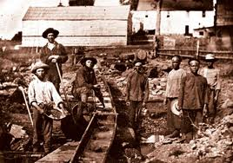

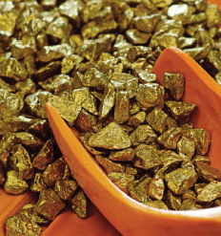
The New Gold Rush … DATA MINING
Current predictive analytics attempt to segment or classify prospects through:
    General demographics – age, gender, marital status, family size, education…
    Occupation – Lawyer, Salesman, Specialist . . .
    Lifestyle Segmentation
    Psychographic Segmentation
    Behavior patterns –prescribing behavior, publishing behavior . . .
    (Amazon.com – “people who bought this, also bought this . . . “)
    There’s an assumption that shared attributes predict shared attitudes.

Slide 19
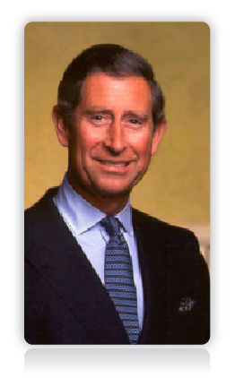
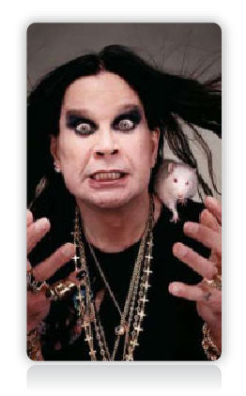
Does This Analysis Let Us Really Know Who Our Customer Is?
SEX:
AGE:
HEIGHT:
NATIONALITY:
FAMILY STATUS:
ANNUAL INCOME:
HOBBIES:
Male
50+
5 ft 10.5 in
British
Married
$10M+
Music, Art,
Philanthropy

Slide 20

Our Science Decodes True Consumer Preferences… …based on science and statistics, but not predictive analytics.
Cuts across traditional segmentation & decodes hidden preferences.
Behavorial Segmentation
Product Usage
Brand Loyalty
Attitudes
Psychographic Segmentation
Lifestyle Type
Personality Type
Social Class
Demographic Segmentation
Age
Gender
Income

Slide 21


Are Surveys Are A Good Place to Start?
When asked, 70% of people say they prefer “Dark, Rich Coffee.”

Slide 22

Maybe not!
When tested,
78% of people
prove they like
weak, milky coffee

Slide 23
A Different Approach Is Needed!

Slide 24

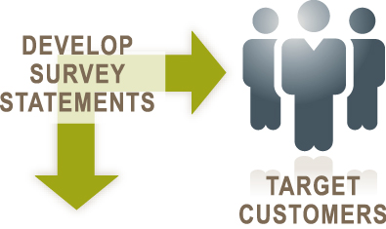
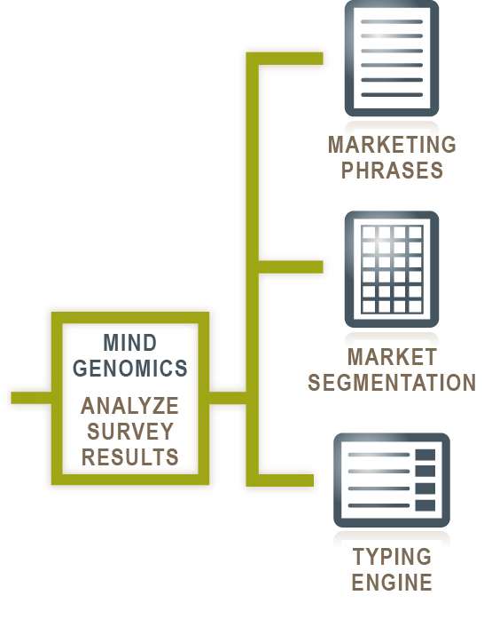


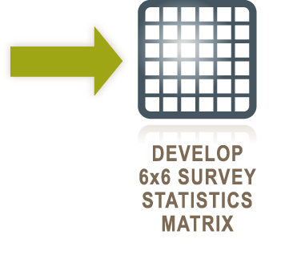

Slide 25
Executive Summary
Overall likelihood to further education is moderate, underscoring the importance of determining the right messaging for the right student
Price/cost is the single most important factor of enrollment influence
There is no single messaging element that is impactful across all three segments
Study has yielded three differentiated student segments that have distinct messaging preferences and slightly differing demographic characteristics
Gender has emerged as a pivotal behavioral attribute

Slide 26
Study Results

Slide 27
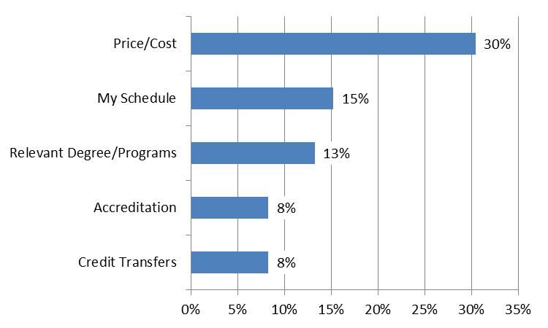
Overall Observations
~30% of the respondents cited “Price/Cost” as the single most important factor that would influence their decision about choosing a school
Open Question: What is the single most important factor that would influence your decision about choosing a distance education college or University?

Slide 28



Student Segmentation
Great Expectations Segment
Convenience Segment
Career Segment

Slide 29
‘Great Expectations’ Segment
‘Great Expectations’ Segment’s most positively impactful statements:
Course of study fits your exact needs
This College is regionally accredited
This College has the best education your money can buy
This College has an outstanding reputation
This College offers a variety of degree programs
Affordable monthly payment plans to fit your needs
Scholarships, grants, and loans are available
Class work fits "around" your work and family schedules
College instructors are experienced and knowledgeable
Technical support is accessible via e-mail or phone 24 hours a day, seven days a week.

Slide 30
‘Great Expectations’ Segment
‘Great Expectations’ Segment’s most negatively impactful statements:
Childcare is necessary during your classes

Slide 31
‘Convenience’ Segment
‘Convenience’ Segment’s most positively impactful statements:
Accepts more transfer credits
Scholarships, grants, and loans are available
Professors offer guidance and support when requested
Individual back to school transition help
You believe that you can complete your degree program
Customized programs to match your budget
Attend class when it fits your schedule…with on demand learning
The College offers adequate technical support
Short-term programs to graduate faster

Slide 32
‘Convenience’ Segment
‘Convenience’ Segment’s most negatively impactful statements:
Having a degree is important to your co-workers and peers
Discounted computers and software purchase programs available
College instructors are experienced and knowledgeable
Having a degree is necessary for your employer
Earning a degree will help you get a job in a new profession or field
Your tuition is an investment in your future
Childcare is necessary during your classes

Slide 33
‘Career’ Segment
‘Career’ Segment’s most positively impactful statements:
Having a degree is important to your co-workers and peers
Going back to school
Earning a degree will help you make more money
New classes start frequently
Having a degree is necessary for your employer
The College offers adequate technical support
Earning a degree will help you get a job in a new profession or field
Learning new information and acquiring new skills will help you grow in your career
Short-term programs to graduate faster
Professors offer guidance and support when requested

Slide 34
‘Career’ Segment
‘Career’ Segment’s most negatively impactful statements:
This College offers a variety of degree programs
This College has the best education your money can buy
This College is regionally accredited
Customized programs to match your budget
Scholarships, grants, and loans are available
Course of study fits your exact needs
Your tuition is an investment in your future
Affordable monthly payment plans to fit your needs
Discounted computers and software purchase programs available
Customize your pace of education with your ability to pay

Slide 35
Demographic & Behavioral Characteristics

Slide 36
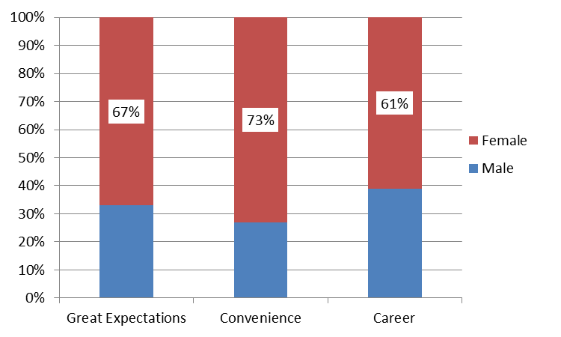
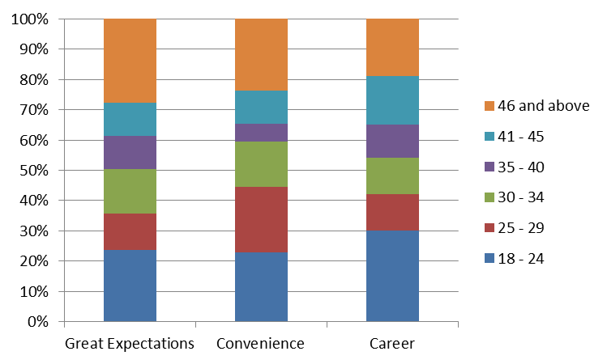
Demographics By Segment –
Gender & Age
The ‘Convenience’ segment students tend to skew more female (73%)
  ‘Career’ students tend to skew more male than other groups (61%)
‘Great Expectations’ students tend to be older (29% are >45 y.o.)
Gender Mix by Student Segment
Age Range by Student Segment

Slide 37
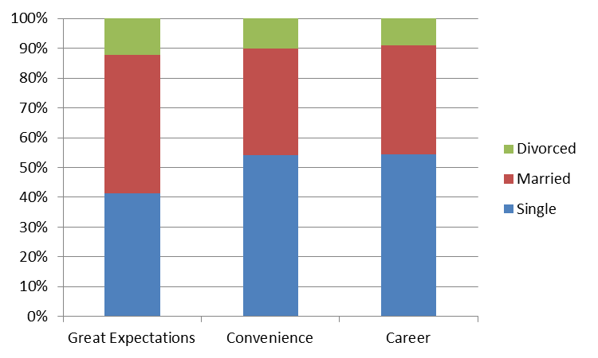
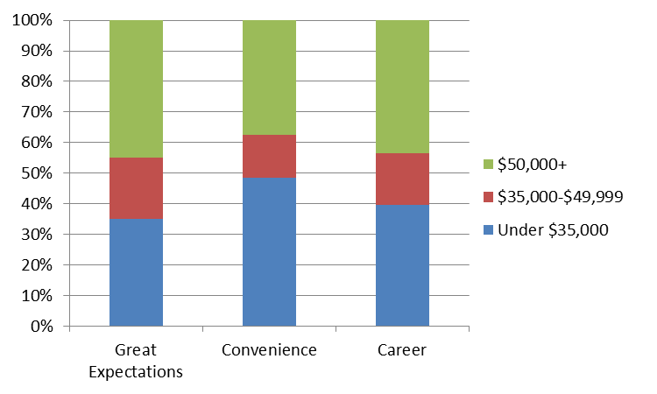
HH Income & Marital Status
Marital Status by Segment
Great Expectations students have the highest HH Income and are more likely to be married
HH Income by Student Segment

Slide 38
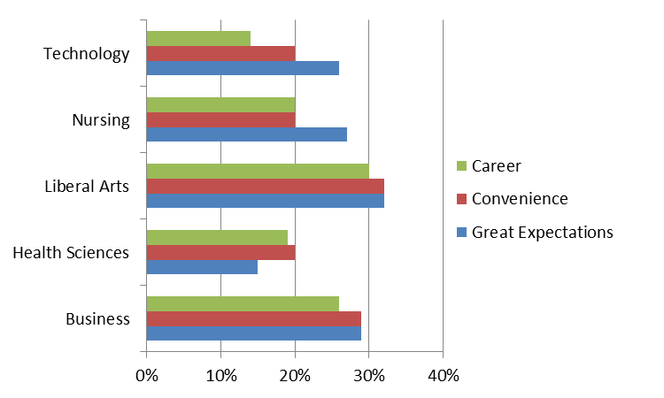
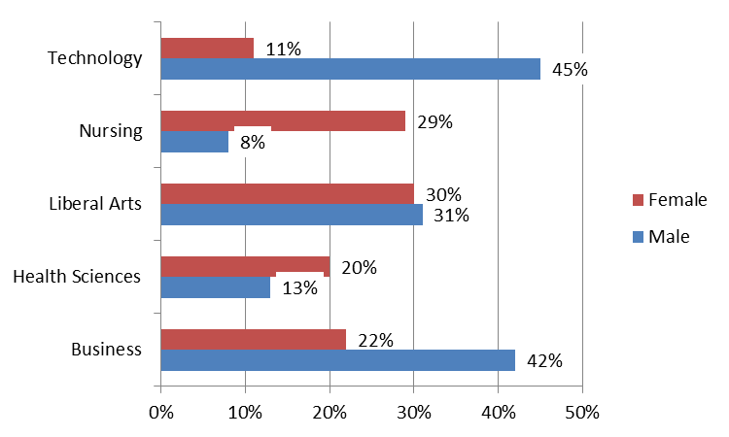
Courses of Interest –
Segment vs Gender
There are differences in courses of interest across segment and, more drastically, across gender
While business is of similar interest across segment, there is a large disparity across gender
Courses by Segment
Courses by Gender
Q: What course(s) are you interested in taking?

Slide 39
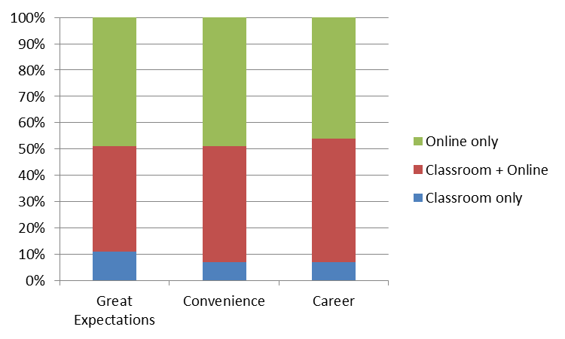
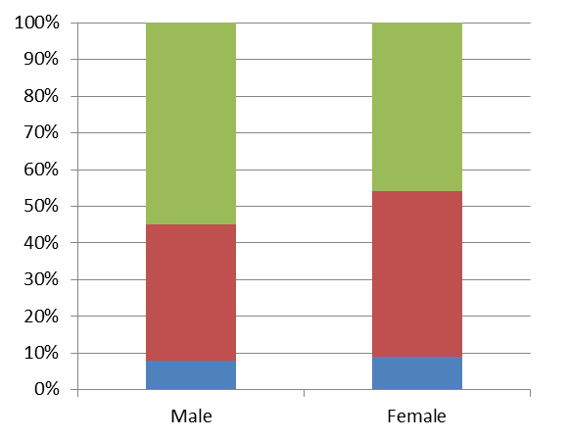
Education Format –
Segment vs Gender
While there is very little difference in education format preference across the segments, we do see some difference across gender
  55% of male respondents prefer online only, vs. 46% of female students
Format by Student Segment
Format by Gender
Q: Your preferred education format is:

Slide 40
Next Steps

Slide 41
Next Steps
Implement Addressable Minds Messaging
  Call Center
  Web Site
  E-mails
  Brochures
Establish Test & Learn framework to:
  measure lift from typing tool implementation and personalized messaging
  continue refinement of messaging for each segment

Slide 42
Implementing Addressable Minds Messaging is a rapid process
Adapt, Test & Train Use of Addressable Minds in Initial Controlled Areas
Rollout the use of Addressable Minds to all areas of Prospect Communications
Create Addressable Mind Segments, Messaging, Segment Analyzer
Communication Touch Points:
Call Center
Web Site
E-Mails
Brochures
- Advertizing
Select Functions & Staff
- Set up training program
Build technology support
Create marketing collateral
Establish & measure benefits
Develop help desk support
Publish executive communications
Test vis-à-vis control – track results

Slide 43

Implement Addressable Minds Segment Messaging
Call Center Admissions Rep
Web Site Prospect
  1 - Identify the prospect’s Addressable Minds segment membership
  2 - Use segment specific messaging when communicating with that prospect

Slide 44
Typing tool Link

Slide 45
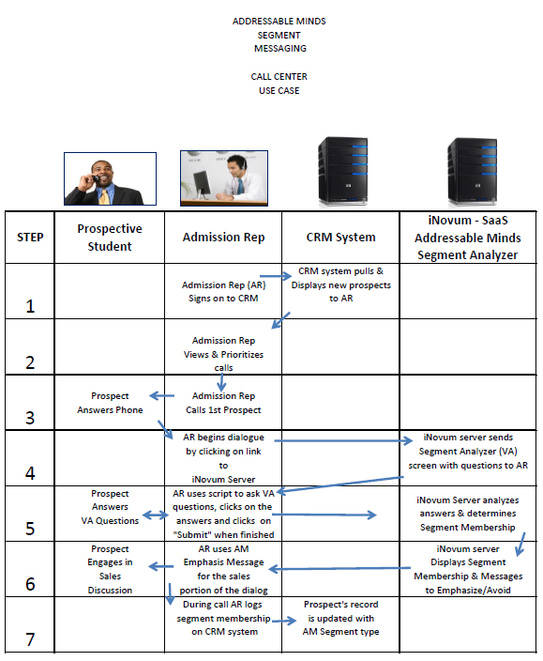

Slide 46
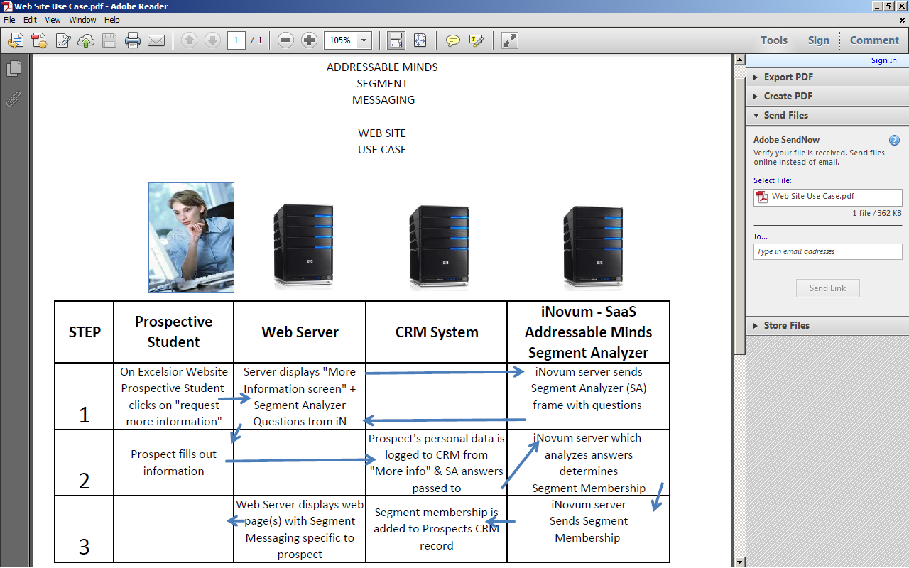
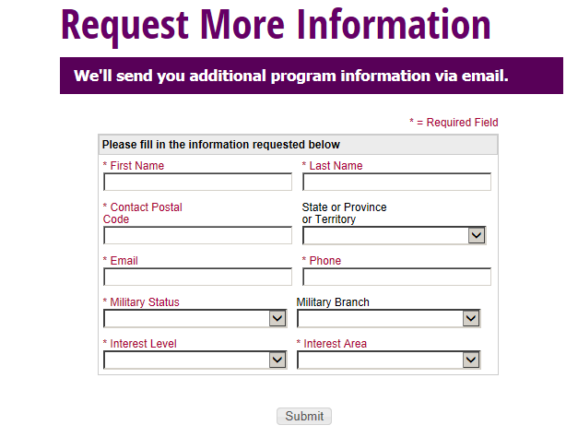

Slide 47
Appendix

Slide 48
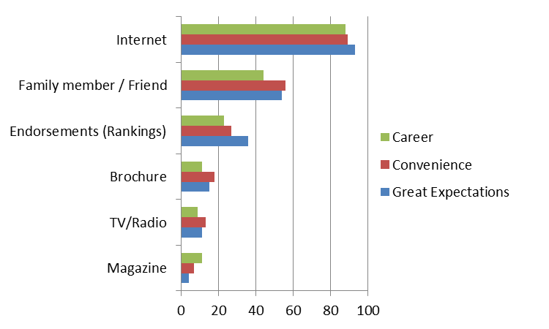
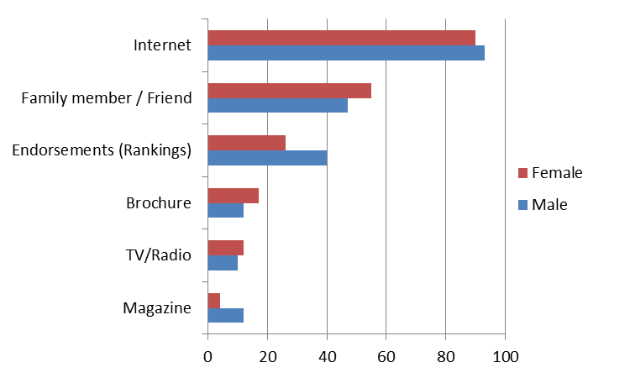
Top 3 Sources –
Segment vs Gender
‘Internet’ is the #1 source for college research, followed by family/friends
Males cited endorsements as a source at a higher rate than females
Sources by Segment
Sources by Gender
Q: What are your top three sources you use to research distance education colleges or Universities?

Slide 49
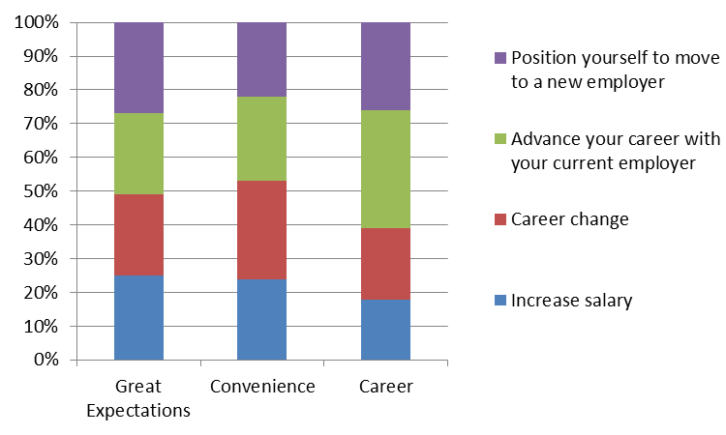
Reason for Furthering Education
Career advancement with current or new employer is the key factor for ‘Career’ segment students
‘Reason’ by Segment
Q: Why do you wish to further your education?

